Slide 1
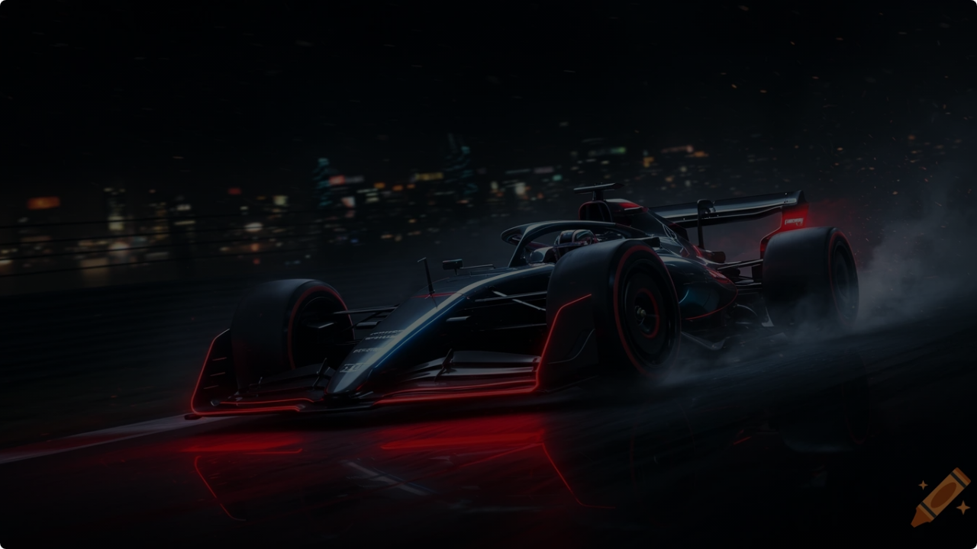



Advanced ML Algorithms in Formula 1
A Comprehensive Literature Survey Ashish Ghatkar | Zayaan Ghauri | Daksh Girdhar | Ridham Jain

Slide 2
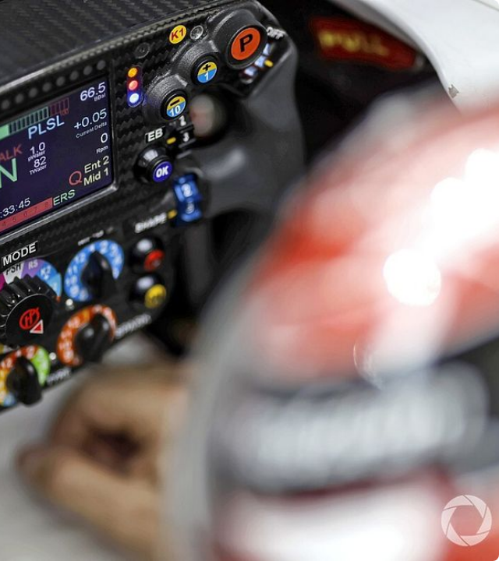

Introduction & Motivation
•
Machine learning is essential in F1, where marginal performance gains determine victory or defeat.
•
Vast amounts of data from telemetry, simulations, and competitor analysis require advanced ML to extract meaningful insights.
•
ML is leveraged to optimize aerodynamics, predict tire strategies, analyze driver behavior, and refine overall race performance.
•
The ability to interpret patterns and predict outcomes provides a crucial strategic edge in this technology-driven sport.

Slide 3


Evolution in F1
Key Challenges
The sport has evolved from rudimentary statistical analysis to employing sophisticated, real-time AI-driven approaches.
Implementing ML in F1 is not without obstacles:
•
Data Volume: Managing and interpreting the sheer volume and complexity of data generated.
•
Deep learning techniques refine car designs and optimize mechanical components.
•
Real-time Processing: Split-second decisions require instantaneous data processing.
•
Cloud computing enables seamless data sharing and collaborative analysis across global teams.
•
Secrecy: Data security is paramount, as insights are a core strategic edge.
•
Regulation: FIA rules impose constraints on how ML can be applied.

Slide 4
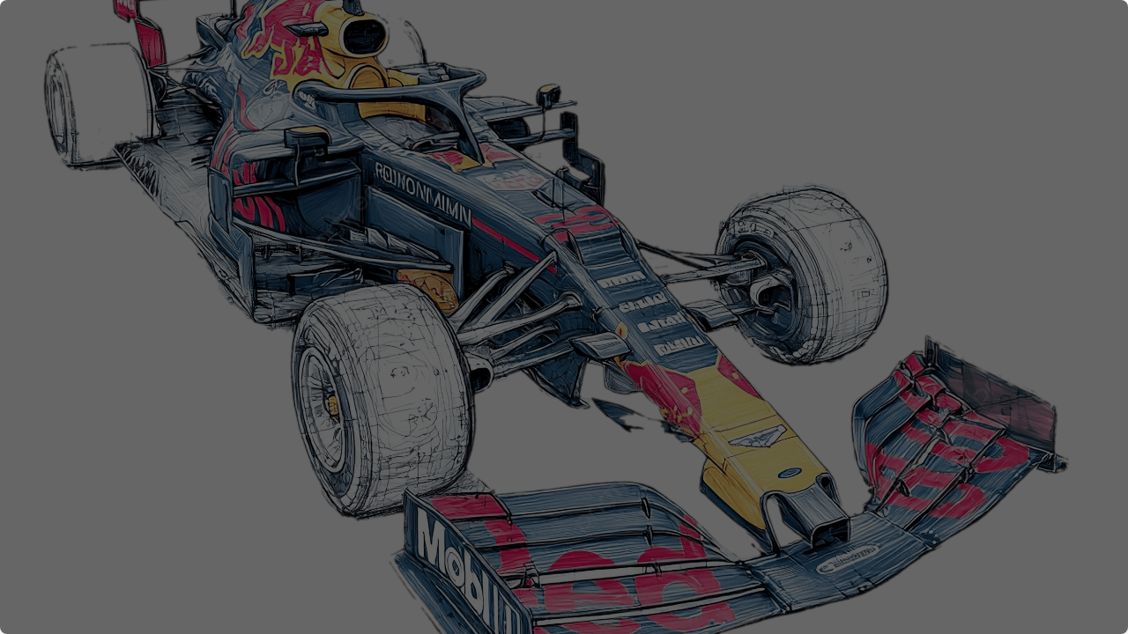
Methodology: Four Key Research Areas

Slide 5




Somaiya
TRUST
Methodology 1: Aerodynamics
ML for Motorsport Aerodynamics
Key Techniques
"Machine learning for Motorsport Aerodynamics" (Watts et al., 2019)
This study investigates integrating Computational Fluid Dynamics (CFD) simulations with ML algorithms to enhance aerodynamic efficiency.
•
Principal Component Analysis (PCA): Used to reduce the dimensionality of aerodynamic parameters, focusing on the most critical factors.
•
Artificial Neural Networks (ANNs): Employed to predict aerodynamic efficiency based on various input parameters from simulations.

Slide 6




Somaiya
TRUST
Methodology 2: Tire Strategy
Predicting F1 Compound Decisions
Key Techniques
"From Data to Podium" (Leischner, 2023)
This paper explores developing models to predict the ideal tire compound choices for different race scenarios, a critical aspect of race strategy.
Models were trained on historical data, weather, and track conditions using:
•
Decision Trees & Random Forests: Used for classification to determine the optimal tire.
•
Gradient Boosting Machines (GBM): Employed for improved accuracy in prediction.

Slide 7


TUST
Methodology 3 & 4: Drivers & Learning
Paper 3: Cluster Analysis of F1 Drivers
Paper 4: Competitive Learning
"Racing Your Rival" (Syracuse University, 2021)
"Learning from... Success and Failure" (INFORMS, 2022)
•
K-Means & Hierarchical Clustering: Used to group drivers based on performance metrics, racing styles, and consistency.
•
Bayesian Learning: Updates belief probabilities based on race outcomes to refine strategies.
•
This enables teams to assess threats and develop targeted strategies.
•
Q-learning (Reinforcement): Applied to optimize race strategy and decision-making under uncertainty.

Slide 8
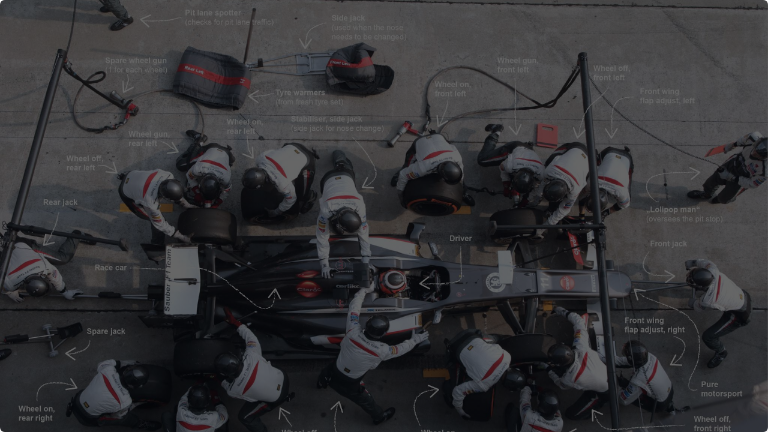
Performance Evaluation & Results

Slide 9
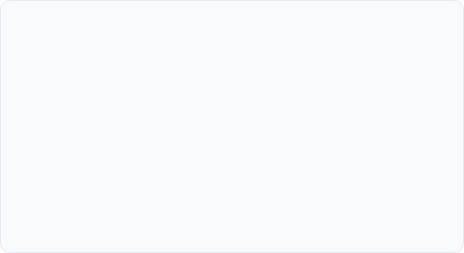

Somaiya
TRUST
Results: Aerodynamics & Tire Strategy
Aerodynamics
Tire Decisions
Machine learning significantly enhances aerodynamic efficiency.
The models proved highly effective in predicting tire choice.
•
PCA successfully reduced data dimensionality, allowing engineers to focus on critical variables.
•
Random Forest and XGBoost models achieved an accuracy of 85% in predicting optimal compounds.
•
Clustering identified optimal aerodynamic configurations, leading to better car performance and fuel efficiency.
•
Feature analysis revealed track temperature and pit stop strategy as the most influential factors.

Slide 10


Somaiya
TRUST
Results: Driver Analysis & Learning
Driver Clustering
Competitive Learning
Analysis revealed distinct groups of drivers (e.g., elite, midfield, strugglers).
Teams that learn from data consistently perform better.
•
NLP of race debriefs and radio shows that teams systematically analyze competitor strategies.
•
Top-tier drivers exhibit unique and superior patterns in race execution, tire management, and overtaking.
•
Data-driven learning and dynamic adaptation contribute to long-term success.
•
This aids in talent scouting and refining strategies based on driver tendencies.

Slide 11


Somaiya
Comparative Analysis: Discussion
Strengths & Applications
Limitations & Improvements
•
Strengths: High predictive accuracy (Paper 2), effective dimensionality reduction (Paper 1), provides clear, actionable segments (Paper 3).
•
Limitations: Difficulty accessing proprietary team data, models may not be fast enough for real-time decisions, reliance on historical data.
•
Applications:
•
Potential Improvements:
○
Real-time strategy calls (Tires).
○
Integrate live telemetry data streams.
○
Optimizing pre-race car setup (Aero).
○
Use Reinforcement Learning for dynamic strategy.
○
Talent scouting & rival analysis (Drivers).
○
Develop XAI models for better interpretability.

Slide 12
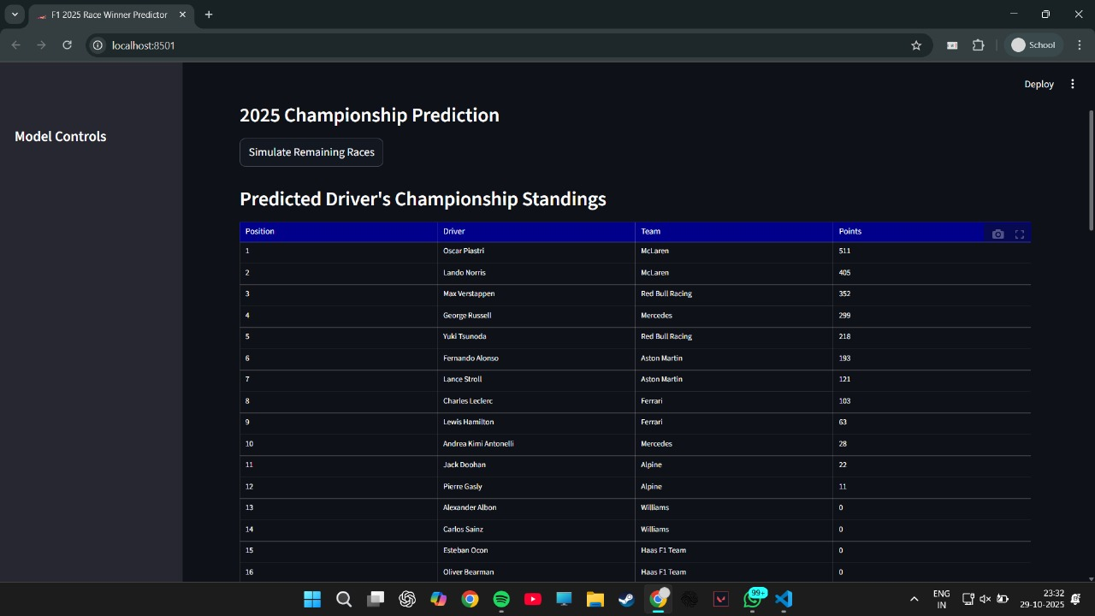
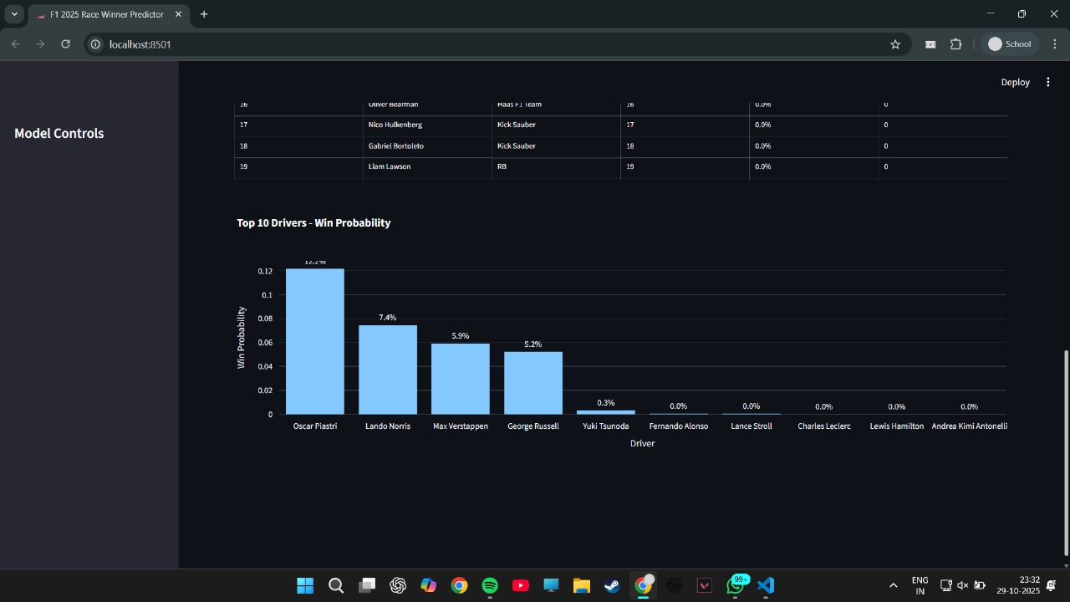
Prototype: F1 Race Winner Predictor
Model Performance
A prototype application was built to predict F1 race winners based on historical data.
Test Accuracy: 96.87%
Test ROC AUC: 98.46%
Validation Accuracy: 99.09%
Validation ROC AUC: 99.85%
The model demonstrates high accuracy and robust performance, providing a strong foundation for predictive analysis.

Slide 13
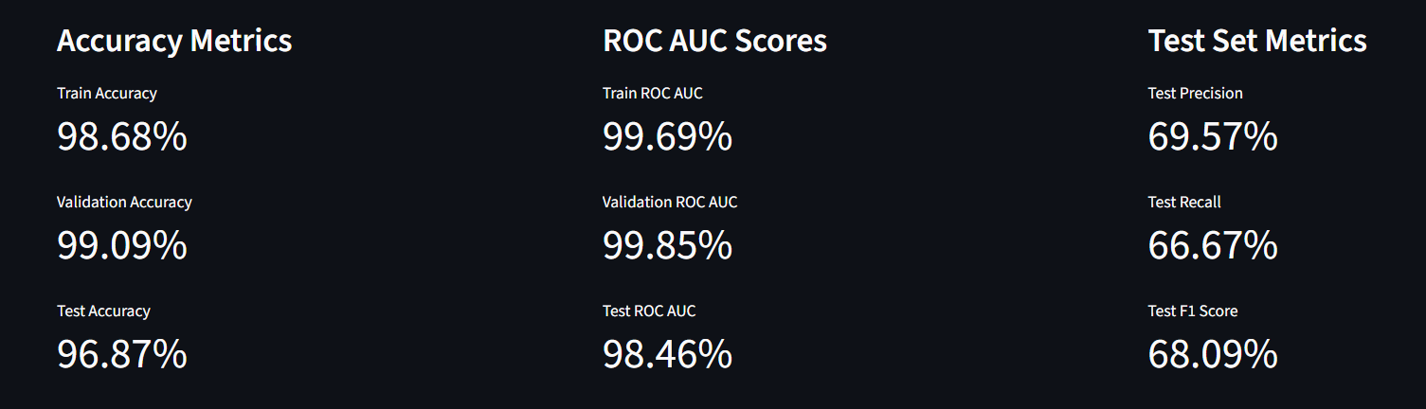
Model Performance

Slide 14
Model Performance

Slide 15
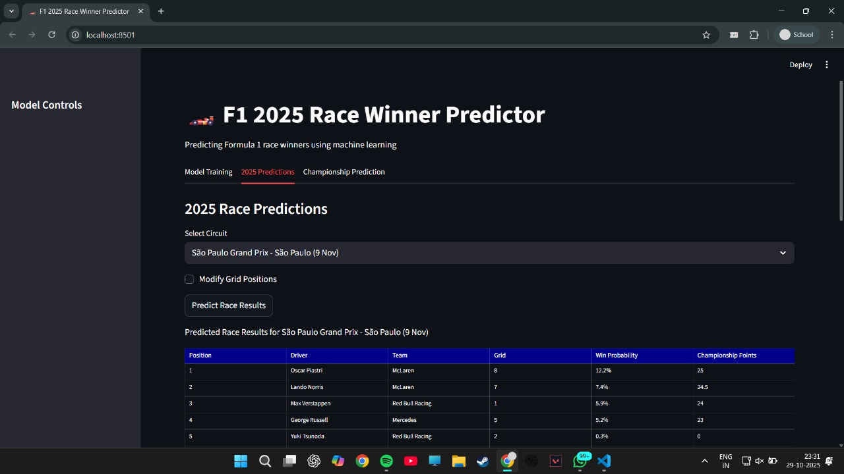
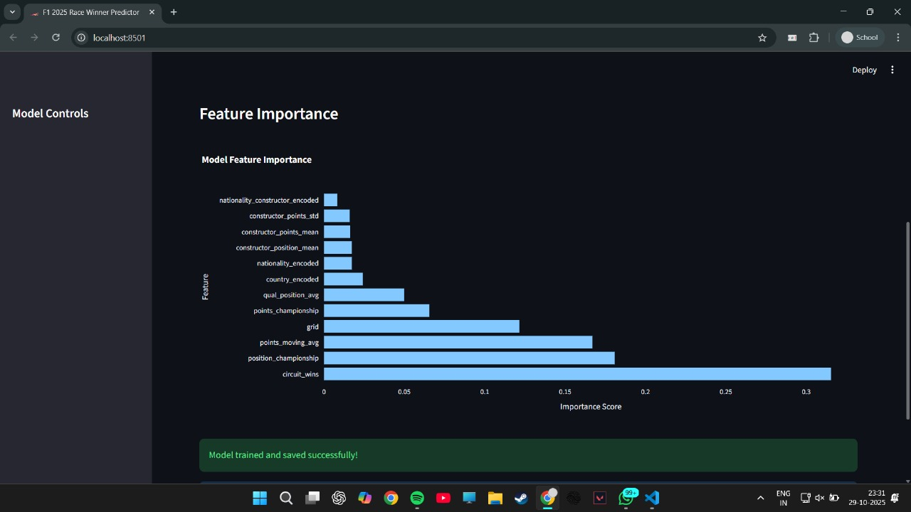
Prototype: Predictions & Feature Analysis
Race Outcome Prediction
The tool predicts race results, win probability, and expected points for specific circuits, like São Paulo.
Feature Importance
Analysis shows 'Circuit Wins' and 'Championship Position' are the most significant factors in predicting a race winner.

Slide 16

Future Scope & Innovations

Slide 17






Somaiya
TRUST
The Future of ML in F1
Real-Time Aero
AI-Driven CFD
Adaptive Strategy
Using live telemetry to dynamically adjust wing angles, DRS configurations, and airflow management during a race.
Using deep neural networks as "surrogate models" to approximate CFD outputs, rapidly testing new aero designs in minutes, not days.
Multi-agent reinforcement learning systems that simulate rival team responses to optimize strategies in real-time.

Slide 18
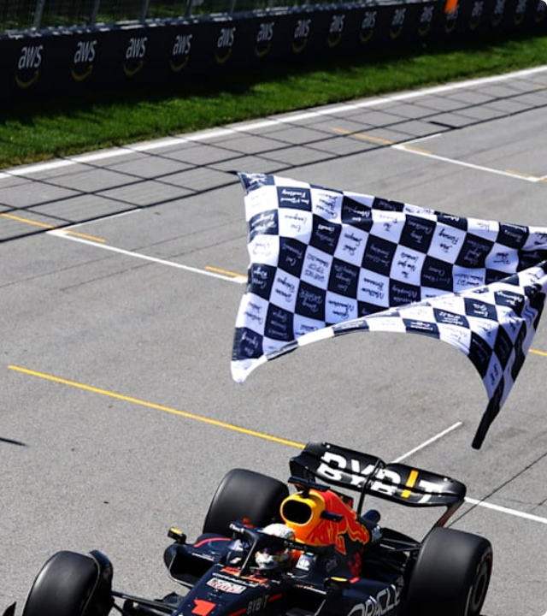
Conclusion
•
ML has fundamentally revolutionized F1, enhancing aerodynamics, tire strategy, and driver analysis.
•
Predictive modeling optimizes car design, while dynamic models refine in-race strategy.
•
Clustering and learning models help teams assess talent and strategically plan against rivals.
•
While challenges in data privacy and computation remain, data-driven decision-making is undeniably at the core of competitive success in Formula 1.

Slide 19
Somaiya
TRUST
Thank you

